Slide 1
IBM University Engagement Project Submission
“Exploring the Power of Agentic AI with IBM Granite and LangFlow”

Slide 2

Project Tile – EduSimplify AI – Personalized Course Content Simplification Agent
Domain of Project – Education
Student Name | Recent Passport Photo | Email ID | Mobile number [WhatsApp]
Pavankalyan V |  | pavan23223@gmail.com | 7019290593
Recommended font style and size:
Font Style: Arial
Font Size (Heading): 28
Font Size (Content): 20

Slide 3
Problem Statement -
Problem Statement : Course Content Simplification Agent
The Challenge
Educational materials are often presented with a high level of complexity, making them difficult for learners with different levels of prior knowledge to understand. Students may struggle with technical terminology, lengthy explanations, and unfamiliar concepts. A single explanation style may not effectively support beginners, intermediate learners, and advanced students.
The Objective
Build an AI-powered Course Content Simplification Agent that analyzes academic content and reframes explanations according to the learner's proficiency level, supporting personalized and inclusive education.
The solution should:
• Personalized Content Simplification – Adapt academic explanations according to Beginner, Intermediate, or Advanced learning levels.
• Academic Content Analysis – Analyze textbooks, notes, and PDF-based course materials and identify important concepts and terminology.

Slide 4
• Multi-Level Explanations – Present the same concept with an appropriate level of technical depth based on learner proficiency.
• Multilingual Learning – Provide simplified explanations in multiple languages while preserving important technical terminology.
• Learning Assistance – Generate real-world analogies, practical examples, key concepts, and important terminology to improve understanding.
• Exam Preparation – Generate exam points, quick revision notes, and MCQ-based quizzes from the provided academic content.
• Interactive Learning Agent – Allow students to provide content through text or PDF documents and receive personalized learning material.
• Downloadable Learning Material – Allow learners to save the generated structured notes for future revision.

Slide 5
Proposed Solution -
Proposed Solution: EduSimplify AI – Course Content Simplification Agent
The proposed solution is an AI-powered Course Content Simplification Agent designed to transform complex academic materials into personalized, easy-to-understand learning content. The system adapts explanations according to the learner's proficiency level, preferred language, and explanation style, supporting inclusive and personalized education.
At its core, the solution accepts academic text or PDF-based course materials as input and analyzes the content to identify important concepts, terminology, examples, and key learning points. The AI then restructures the content according to the selected learner level, ranging from Beginner to Advanced.
The system provides several key learning capabilities:
Content Analysis Module analyzes uploaded academic material and identifies the important concepts, terminology, and information that should be retained during simplification.
Personalization Module adapts the complexity and depth of explanations according to the student's selected level — Beginner, Intermediate, or Advanced.

Slide 6
Multilingual Learning Module generates explanations in multiple languages including English, Kannada, Hindi, Tamil, and Telugu, while preserving important technical terminology.
Learning Assistance Module generates real-world analogies, practical examples, key concepts, important terminology, and simplified explanations to make difficult topics easier to understand.
Exam Preparation Module generates exam points, quick revision notes, and five MCQ-based questions with answers, helping students prepare more effectively.
The solution provides a user-friendly Streamlit interface where students can paste academic content or upload PDF documents, select their learning preferences, and generate personalized learning material.
The AI generation component processes the student's requirements along with the source content and produces structured educational material containing simple explanations, analogies, key concepts, practical examples, exam points, revision notes, quizzes, and a one-line summary.
Overall, EduSimplify AI provides an end-to-end personalized learning assistant that reduces the complexity of academic content and helps students understand, revise, and learn according to their individual proficiency levels.

Slide 7
Technology Used
LangFlow Platform – For visually designing and orchestrating AI workflows and agent-based processing.
• IBM Granite Model – For natural language understanding, content simplification, reasoning, summarization, and personalization of academic material.
• IBM Cloud – Provides the infrastructure to build, deploy, and scale the Course Content Simplification Agent in a reliable and secure environment.
• RAG (Retrieval-Augmented Generation) – Retrieves relevant information from trusted academic sources before generating responses, helping improve the accuracy and reliability of learning content.
• IBM watsonx.ai – For foundation model deployment, AI development, embeddings, and AI governance.
• Vector Database (FAISS/Chroma) – For storing and retrieving academic content embeddings to support RAG-based information retrieval.
• Streamlit – For developing the interactive user interface through which students can upload PDFs, enter text, select learning preferences, and view personalized learning material.
• Python – For implementing PDF processing, AI integration, prompt processing, and application logic.

Slide 8
Langflow component Used -
1) Chat Input – Interface where students provide their academic content, queries, learning level, language preference, and explanation style.
2) IBM watsonx.ai Agent – Processes the student's input using IBM Granite models to analyze and simplify academic content according to the selected proficiency level.
3) Name of IBM Granite Model – Granite-4.0-8B-Instruct → Used for natural language understanding, reasoning, summarization, and personalized course-content generation.
4) Chat Output – Displays AI-generated learning material such as simplified explanations, real-world analogies, key concepts, practical examples, exam points, quick revision notes, and MCQ quizzes.
5) File Component – Accepts academic PDF documents and provides course material to the AI workflow for content analysis and simplification.
6) Prompt Template – Structures the student's content and learning preferences into a clear instruction for the Granite model to generate personalized educational material.

Slide 9
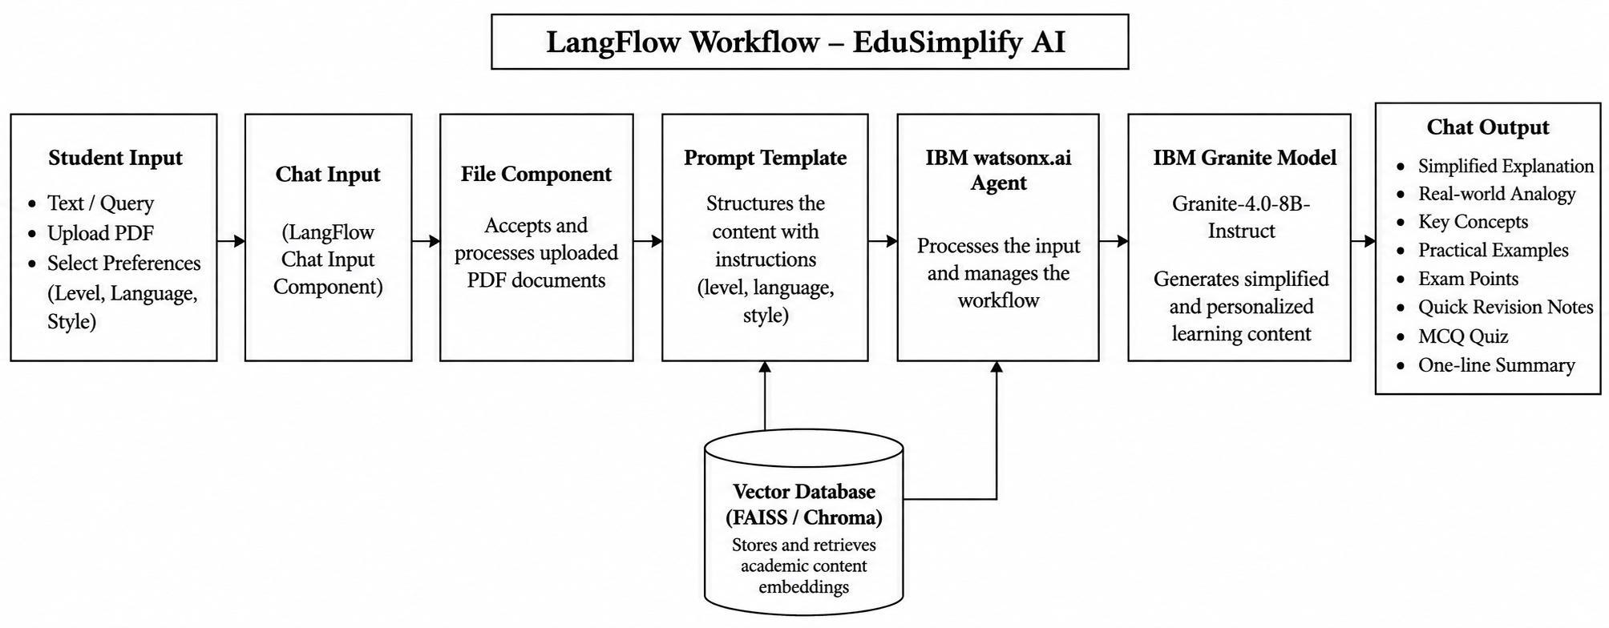
Langflow workflow -

Slide 10

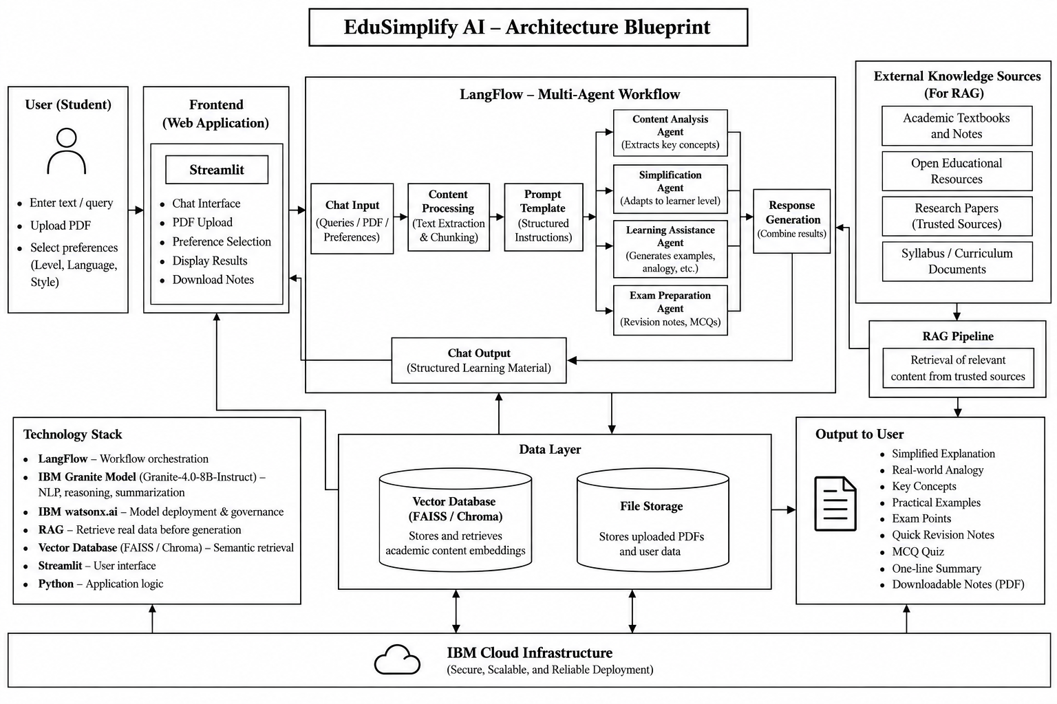

Slide 11

Role of Agentic AI in the solution
Agentic AI enables EduSimplify AI to intelligently analyze academic content, understand learner requirements, and generate personalized learning material rather than providing a generic explanation.
Content Analysis – Analyzes academic text/PDFs and identifies important concepts and terminology.
Learner Adaptation – Determines the appropriate explanation depth based on Beginner, Intermediate, or Advanced level.
Personalized Generation – Generates explanations, analogies, examples, revision notes, and quizzes according to the learner's preferences.
Multilingual Assistance – Produces learning content in the student's selected language while retaining essential technical terms.
Context-Aware Processing – Uses the provided academic content and relevant retrieved information to maintain context and improve responses.
Autonomous Task Execution – Coordinates multiple stages such as content analysis, simplification, learning assistance, and exam preparation to produce a complete learning package.
Interactive Learning – Responds dynamically to different student inputs and preferences.

Slide 12
Novelty and Uniqueness
The proposed EduSimplify AI stands out by combining Agentic AI, personalization, multilingual learning, and adaptive content simplification into a single intelligent educational system.
Adaptive Learning – Instead of providing the same explanation to every student, the system adjusts content according to Beginner, Intermediate, and Advanced proficiency levels.
Personalized Explanations – Tailors the depth and presentation of academic concepts according to the learner's selected level, language, and explanation style.
Multilingual Education – Supports English, Kannada, Hindi, Tamil, and Telugu, making technical educational content more accessible to learners.
AI-Powered Content Transformation – Converts complex academic material into simple explanations, real-world analogies, practical examples, and key concepts.
Exam-Oriented Intelligence – Automatically generates exam points, quick revision notes, and MCQ quizzes, reducing the need for separate preparation material.
PDF-to-Learning Material – Allows students to upload academic PDFs and transforms lengthy course material into structured and easier-to-understand learning content.
Agentic Workflow – Coordinates multiple intelligent tasks such as content analysis, simplification, learning assistance, and exam preparation to produce a complete personalized learning package.
Inclusive Education – Helps learners with different levels of prior knowledge understand the same academic content at an appropriate level of complexity.

Slide 13
Git Hub Link
Github URL – https://github.com/Pavan23223/EduSimplify-AI
·
·
·

Slide 14
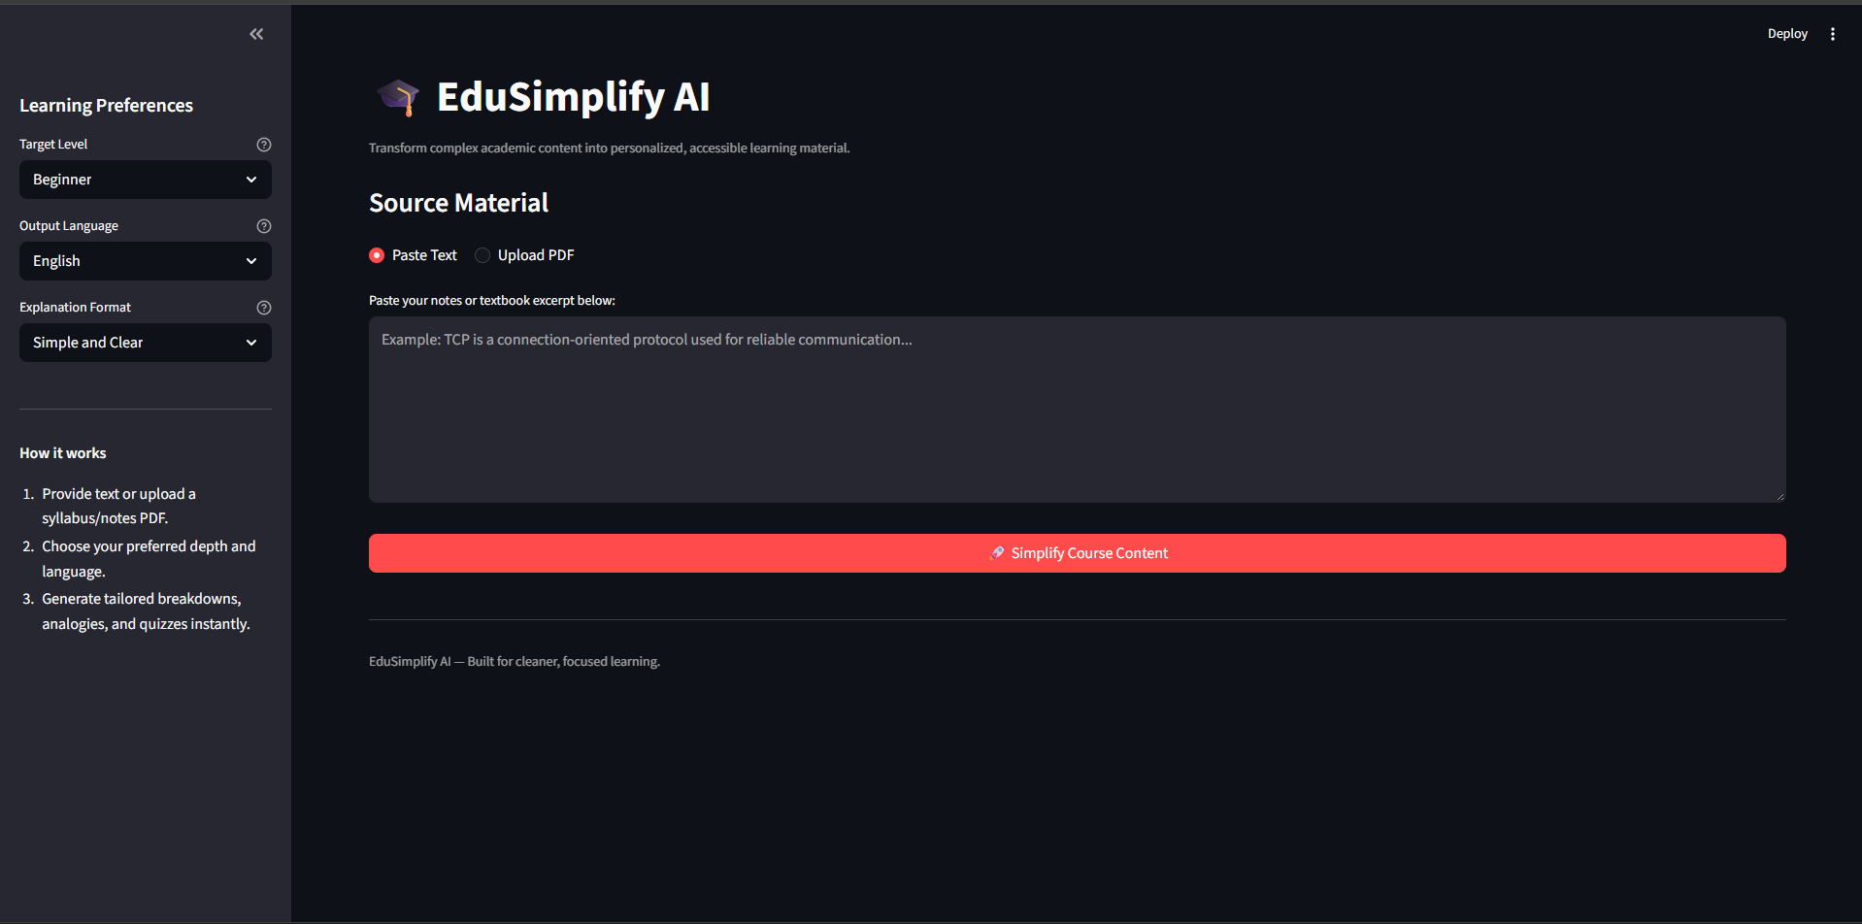
Project Screenshots
Home / Input Screen

Slide 15
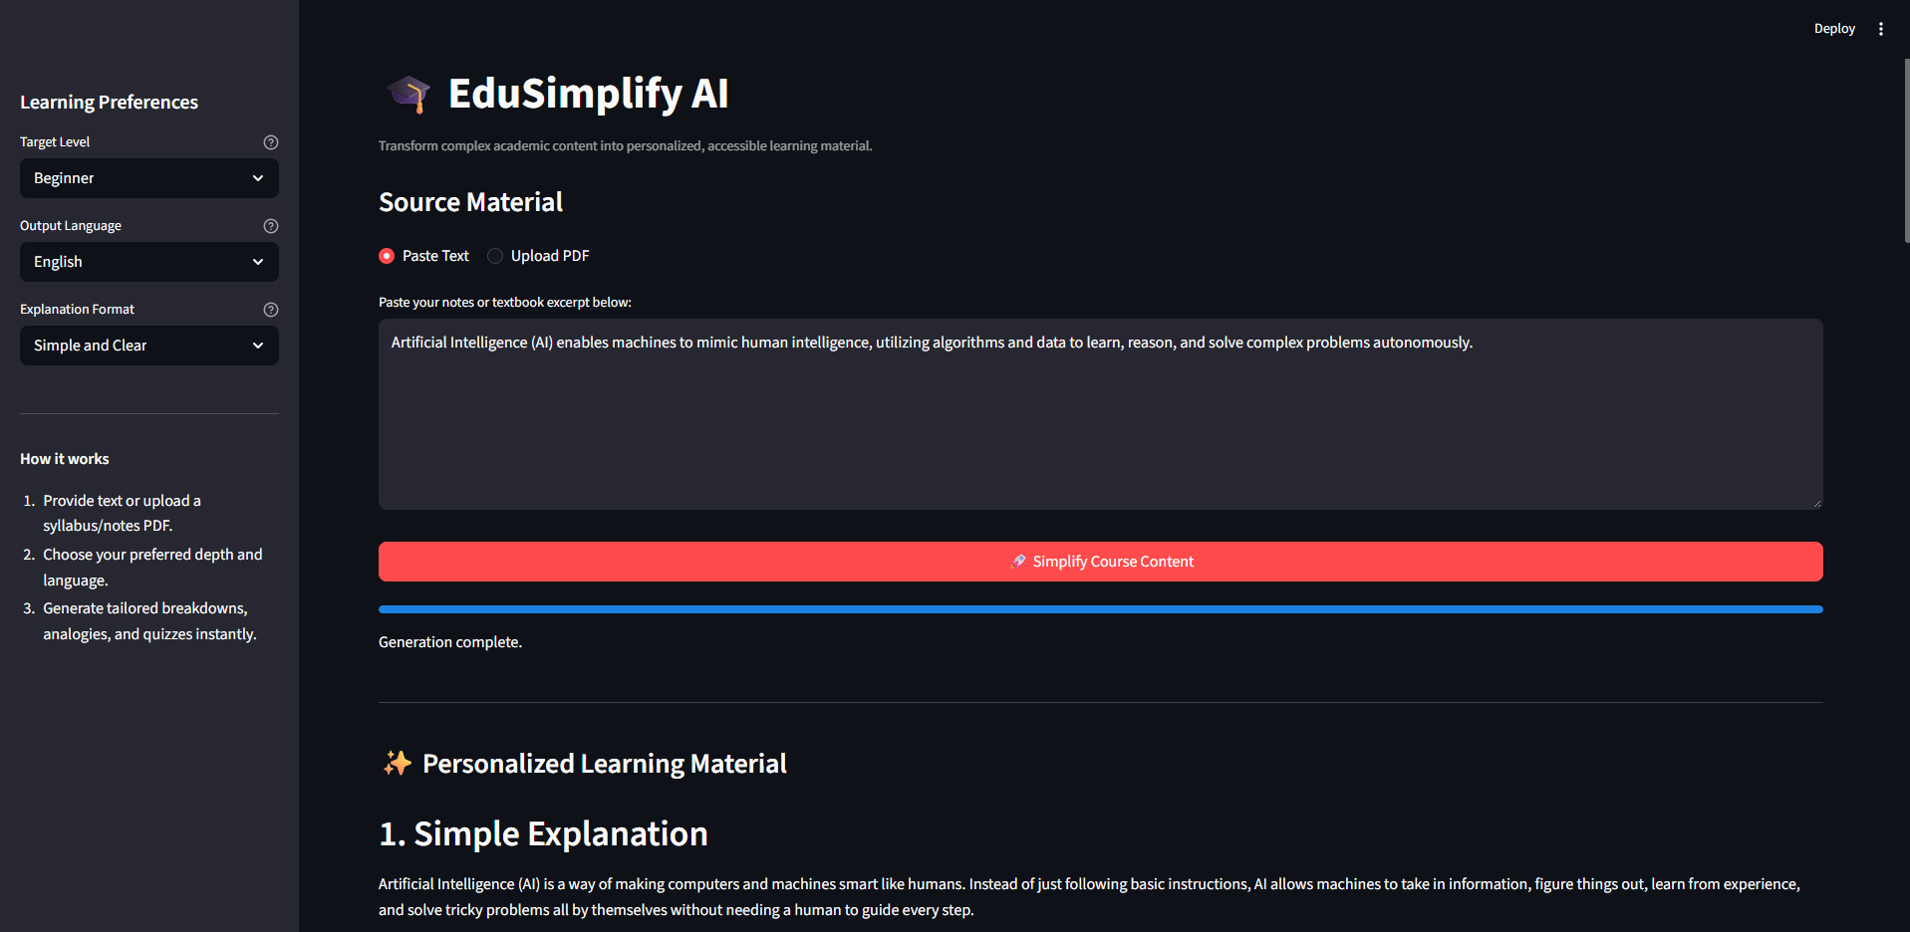
Personalized Learning Output

Slide 16
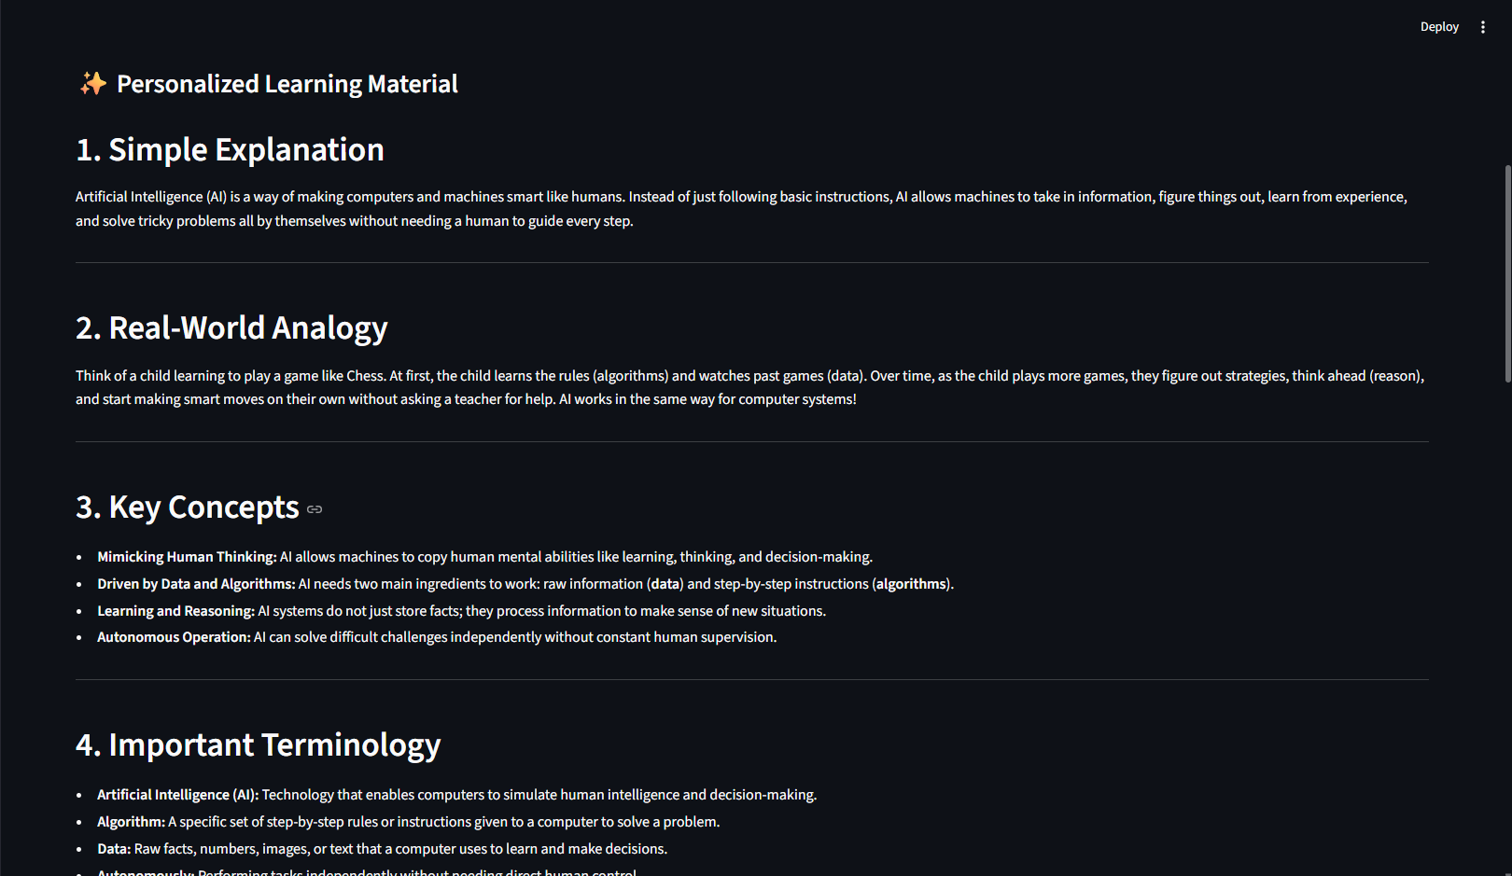
Personalized Learning Output

Slide 17
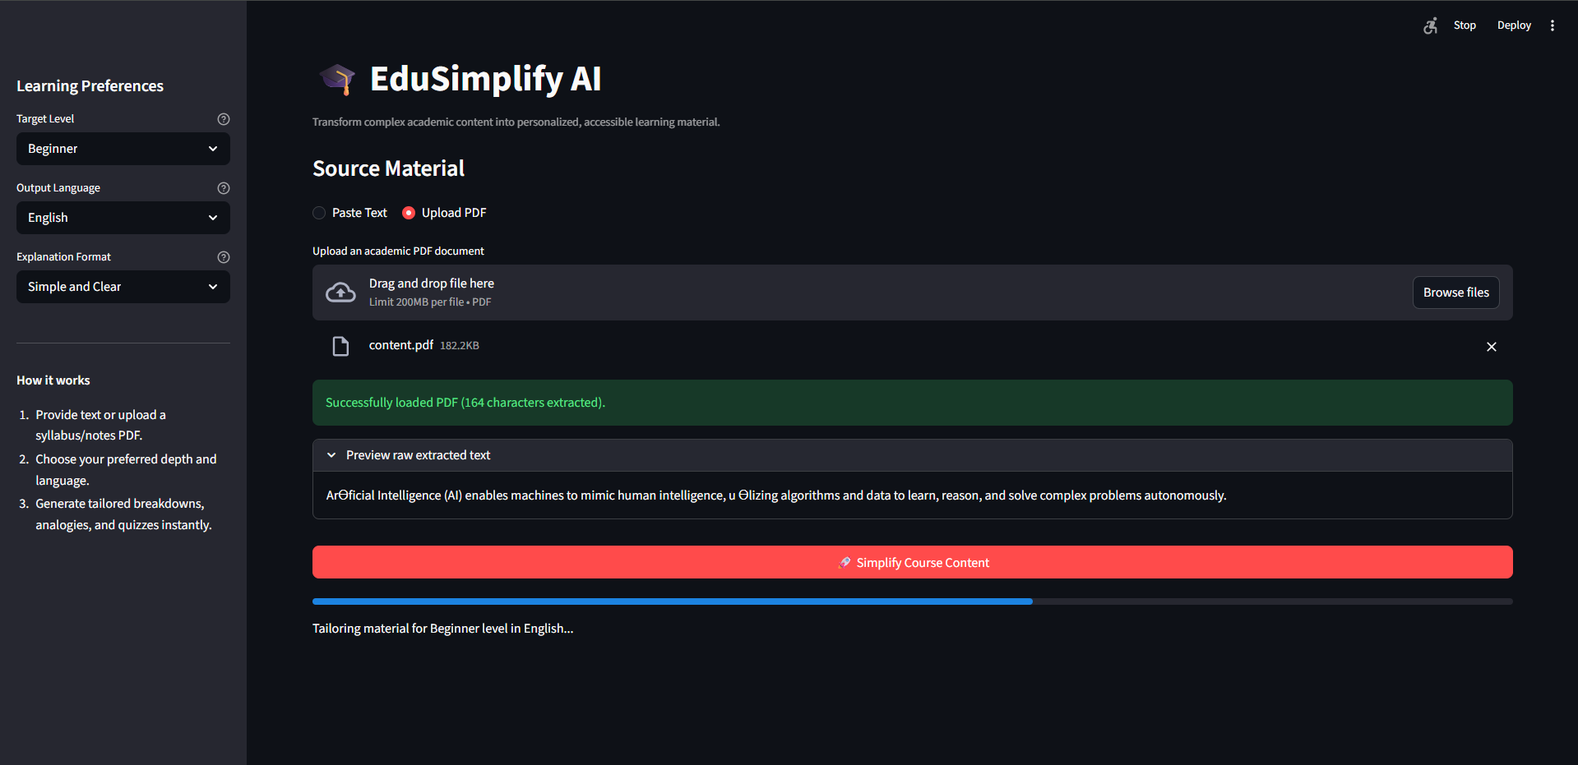
PDF Upload Screen

Slide 18
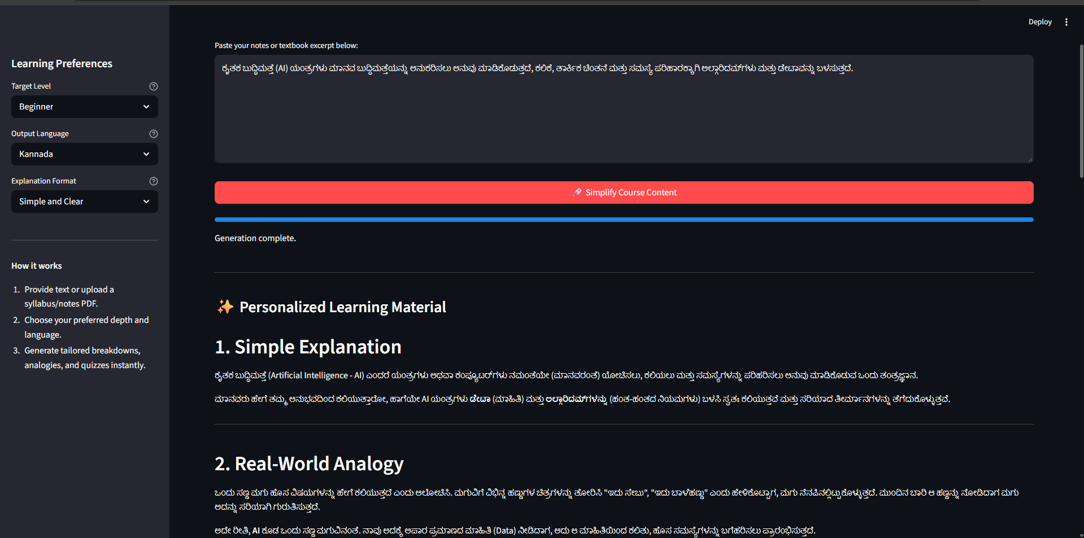
Multilingual Learning Option

Slide 19
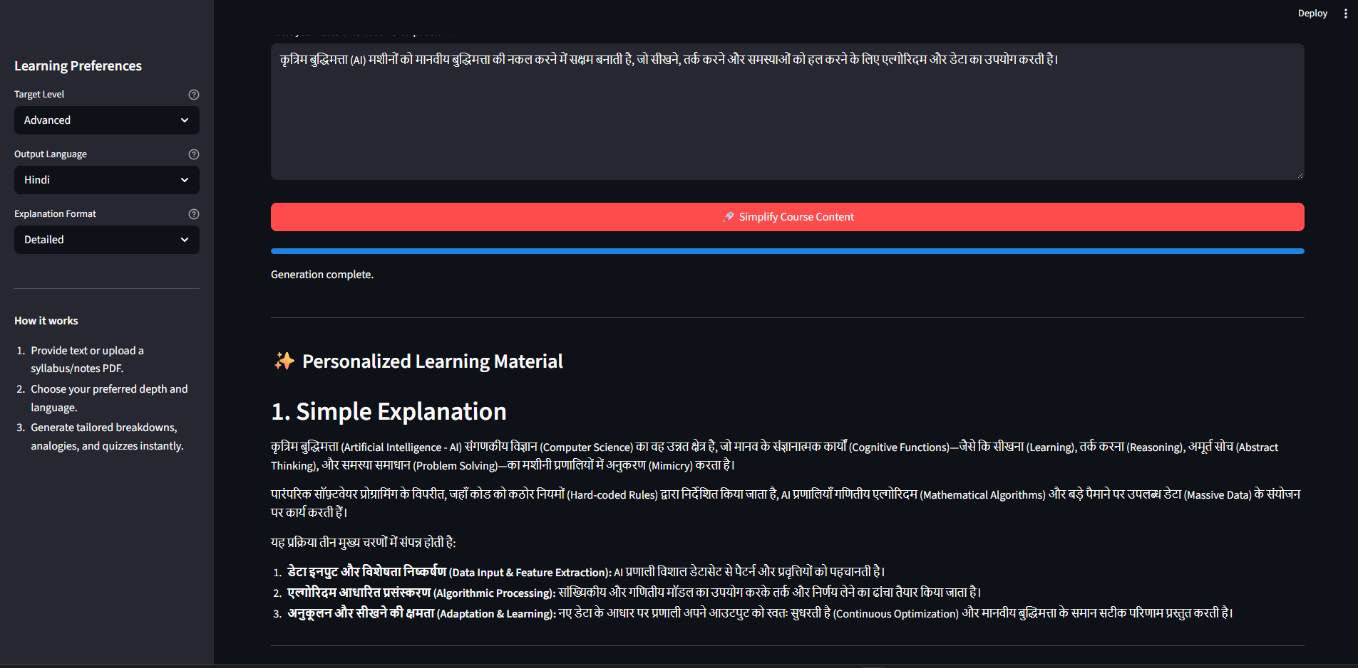
Multilingual Learning Option

Slide 20
Future Scope
1. AI-Powered Voice Assistant & Multilingual Expansion –
The system can be enhanced with a voice-enabled learning assistant and additional regional languages. Students will be able to interact naturally through voice and receive simplified academic explanations in their preferred language, improving accessibility and inclusiveness.
2. Personalized Learning Progress Tracking –
The system can track a student's topics studied, quiz performance, learning level, and revision history to provide more personalized recommendations and identify areas that require additional attention.
3. Voice-Based & Interactive Learning –
Students could ask questions verbally and receive spoken explanations, examples, and revision assistance, making the system more accessible for different learning preferences.
4. Integration with Educational Platforms –
EduSimplify AI could be integrated with Learning Management Systems (LMS), digital classrooms, and institutional course repositories to automatically simplify course materials and support students throughout their academic journey.
·
·
·

Slide 21
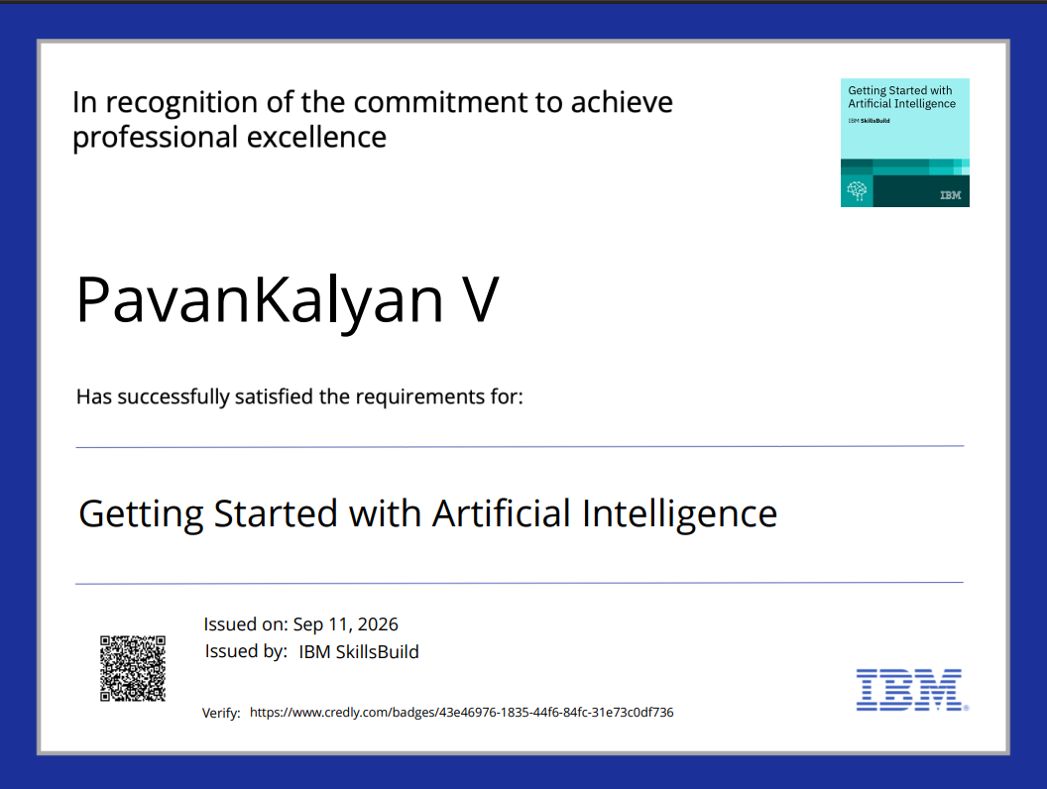
Certificates Earned:
Please add your credly certificate

Slide 22
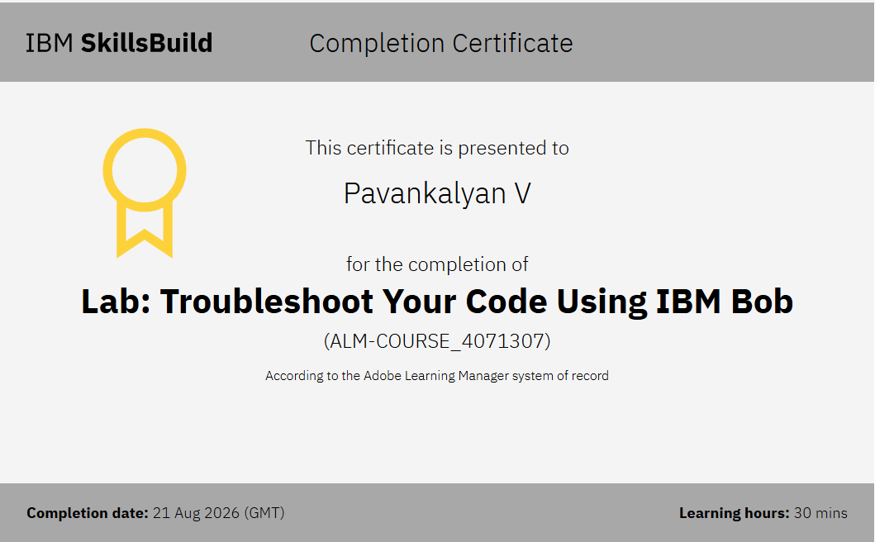
Certificates Earned:​
Add your IBM BOB Certificate

Slide 23


